Slide 1
Chapter 8: ROTATION

Slide 2
This lecture will help you understand:
Circular Motion
Rotational Inertia
Torque
Center of Mass and Center of Gravity
Centripetal Force
Centrifugal Force
Rotating Reference Frames
Simulated Gravity
Angular Momentum
Conservation of Angular Momentum

Slide 3
Circular Motion
When an object turns about an internal axis, it is undergoing circular motion or rotation.
Circular Motion is characterized by two kinds of speeds:
  tangential (or linear) speed.
  rotational (or circular) speed.

Slide 4
Linear speed is the distance traveled per unit of time.
  A point on the outer edge of the turntable travels a greater distance in one rotation than a point near the center.
  The linear speed is greater on the outer edge of a rotating object than it is closer to the axis.
  The speed of something moving along a circular path can be called tangential speed because the direction of motion is always tangent to the circle.

Slide 5
Rotational speed (sometimes called angular speed) is the number of rotations per unit of time.
  All parts of the rigid turntable rotate about the axis in the same amount of time.
  All parts have the same rate of rotation, or the same number of rotations per unit of time. It is common to express rotational speed in revolutions per minute (RPM).

Slide 6
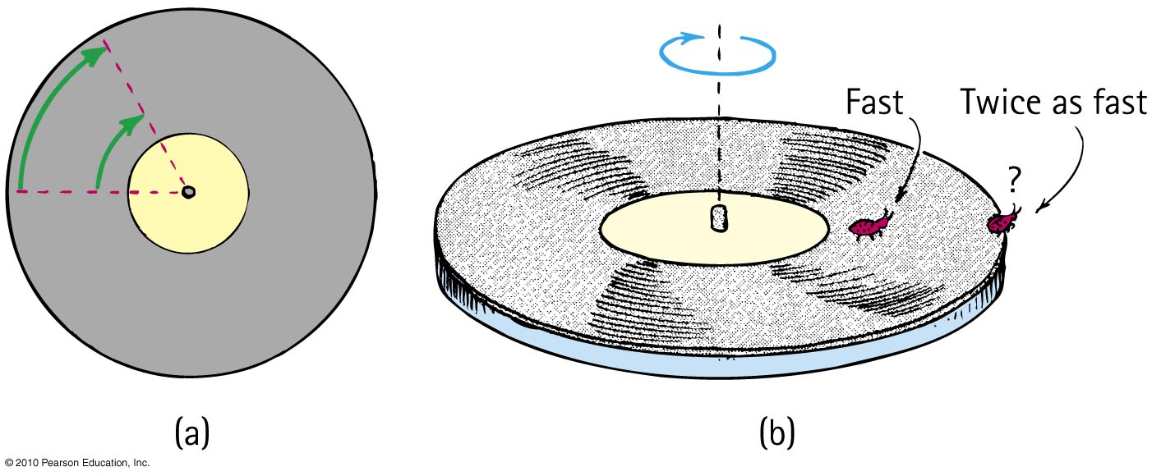
Circular Motion—Tangential Speed
The distance traveled by a point on the rotating object divided by the time taken to travel that distance is called its tangential speed (symbol v).
Points closer to the circumference have a higher tangential speed than points closer to the center.

Slide 7
Circular Motion – Rotational Speed
Rotational (angular) speed is the number of rotations or revolutions per unit of time (symbol ω).
All parts of a rigid merry-go-round or turntable turn about the axis of rotation in the same amount of time.
So, all parts have the same rotational speed.
Tangential speed
= Radial Distance × Rotational Speed
ν = rω

Slide 8
Rotational and Tangential Speed
CHECK YOUR NEIGHBOR
A ladybug sits halfway between the rotational axis and the outer edge of the turntable . When the turntable has a rotational speed of 20 RPM and the bug has a tangential speed of 2 cm/s, what will be the rotational and tangential speeds of her friend who sits at the outer edge?
1 cm/s
2 cm/s
4 cm/s
8 cm/s

Slide 9

Rotational and Tangential Speed
CHECK YOUR ANSWER
A ladybug sits halfway between the rotational axis and the outer edge of the turntable . When the turntable has a rotational speed of 20 RPM and the bug has a tangential speed of 2 cm/s, what will be the rotational and tangential speeds of her friend who sits at the outer edge?
1 cm/s
2 cm/s
4 cm/s
8 cm/s
Explanation:
Tangential speed
=
Rotational speed of both bugs is the same, so if radial distance doubles, tangential speed also doubles.
So, tangential speed is 2 cm/s × 2 = 4 cm/s.

Slide 10
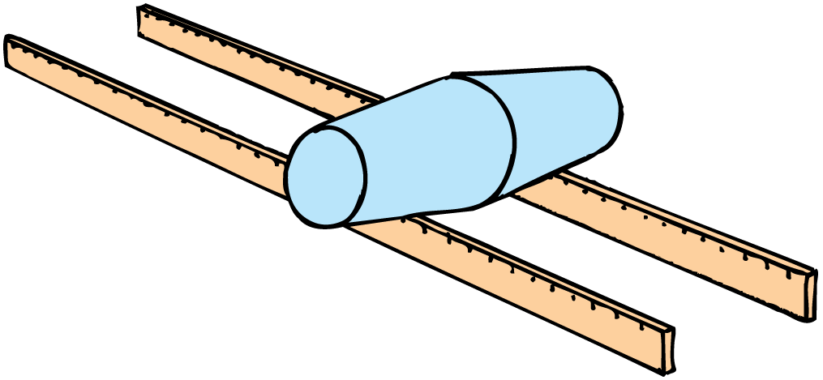
A pair of cups fastened together will stay on the tracks as they roll.

Slide 11
When the pair rolls to the left of center, the wider part of the left cup rides on the left track while the narrow part of the right cup rides on the right track.
This steers the pair toward the center.
If it “overshoots” toward the right, the process repeats, this time toward the left, as the wheels tend to center themselves.

Slide 12
The wheels of railroad trains are similarly tapered. This tapered shape is essential on the curves of railroad tracks.
  On any curve, the distance along the outer part is longer than the distance along the inner part.
  When a vehicle follows a curve, its outer wheels travel faster than its inner wheels. This is not a problem because the wheels roll independent of each other.
  For a train, however, pairs of wheels are firmly connected like the pair of fastened cups, so they rotate together.

Slide 13
Rotational Inertia
An object rotating about an axis tends to remain rotating about the same axis at the same rotational speed unless interfered with by some external influence.
The property of an object to resist changes in its rotational state of motion is called rotational inertia (symbol I).

Slide 14
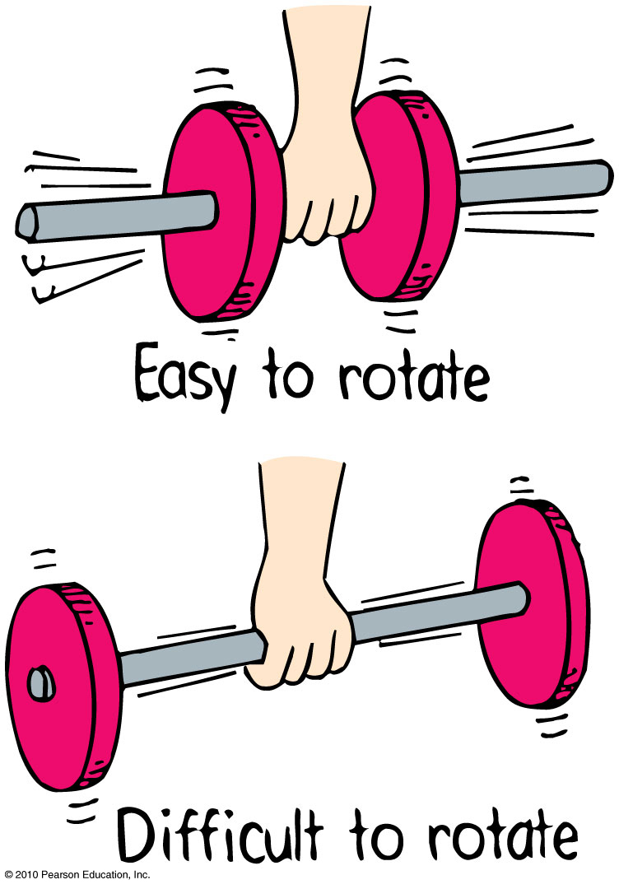
Rotational Inertia
Depends upon
mass of object.
distribution of mass around axis of rotation.
  The greater the distance between an object’s mass concentration and the axis, the greater the rotational inertia.

Slide 15
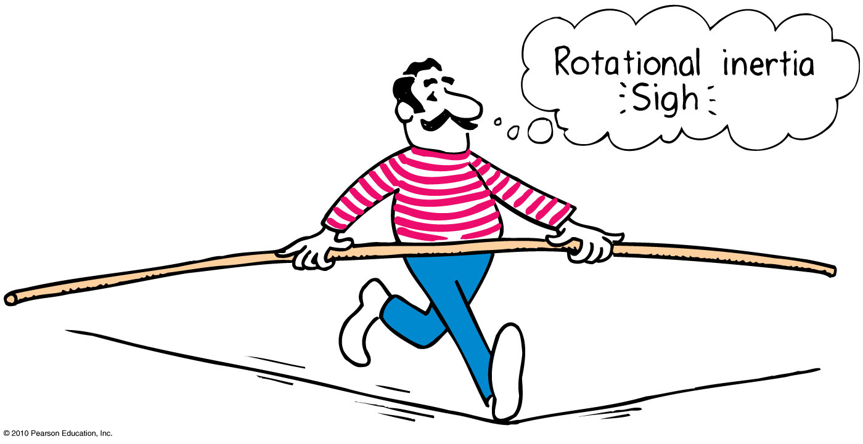
Rotational Inertia
The greater the rotational inertia, the harder it is to change its rotational state.
  A tightrope walker carries a long pole that has a high rotational inertia, so it does not easily rotate.
  Keeps the tightrope walker stable.

Slide 16
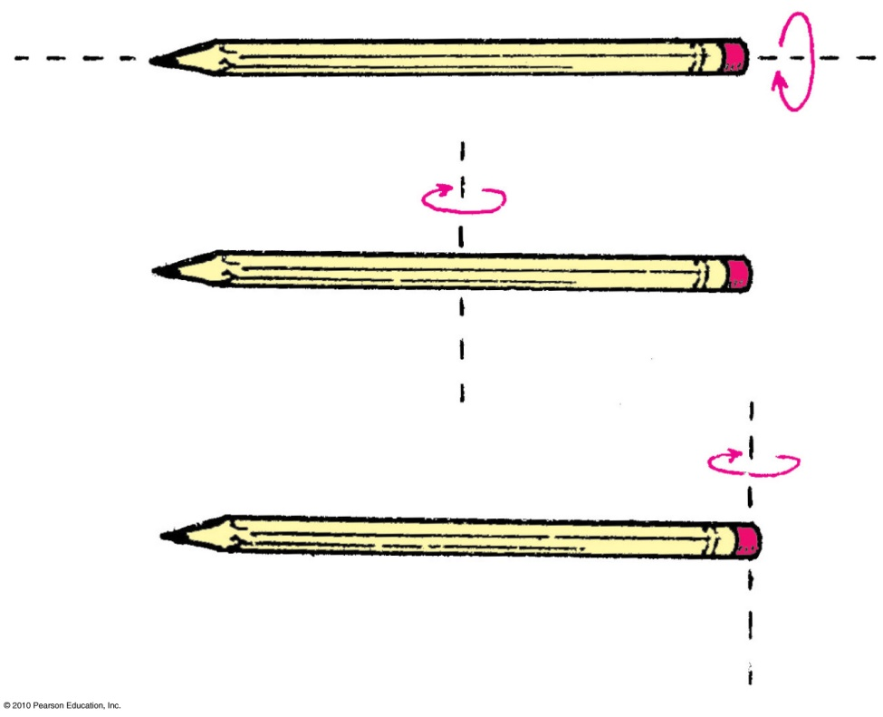
Rotational Inertia
Depends upon the axis around which it rotates
Easier to rotate pencil around an axis passing through it.
Harder to rotate it around vertical axis passing through center.
Hardest to rotate it around vertical axis passing through the end.

Slide 17
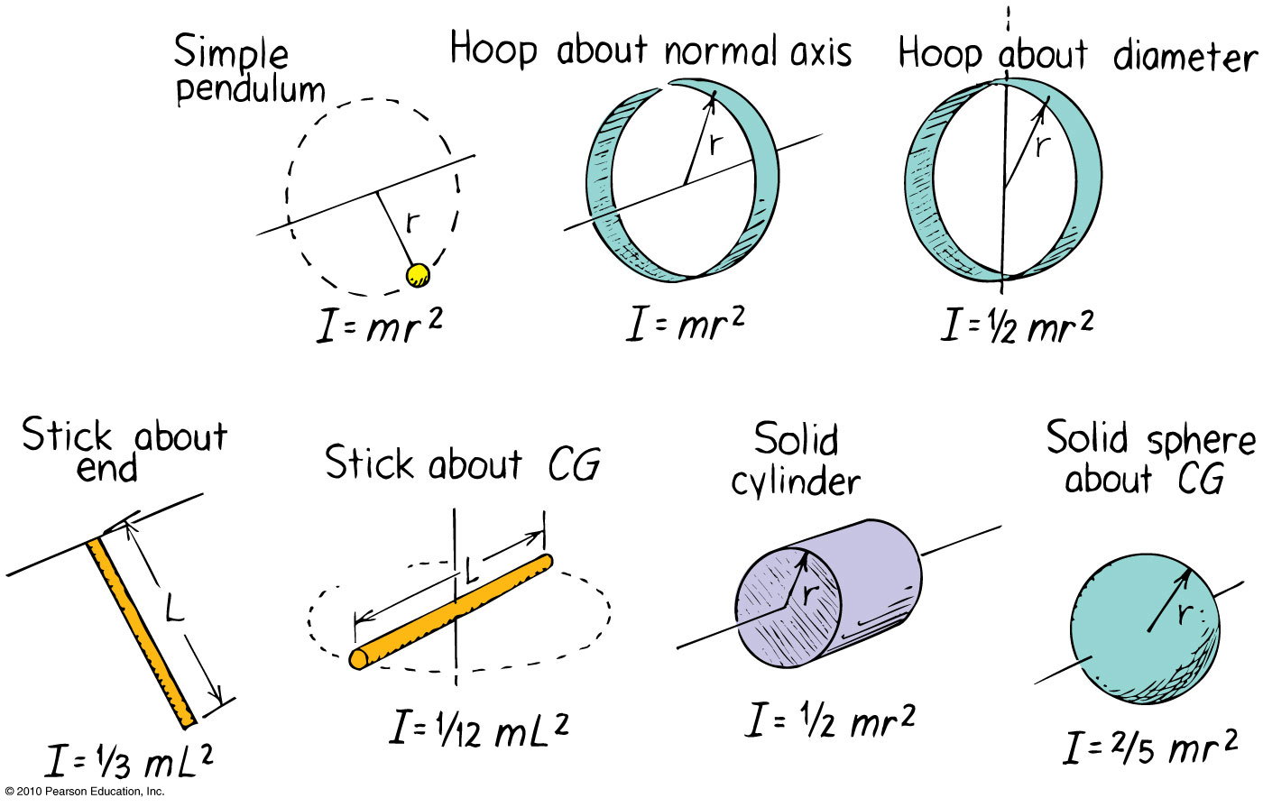
Rotational Inertia
The rotational inertia depends upon the shape of the object and its rotational axis.

Slide 18
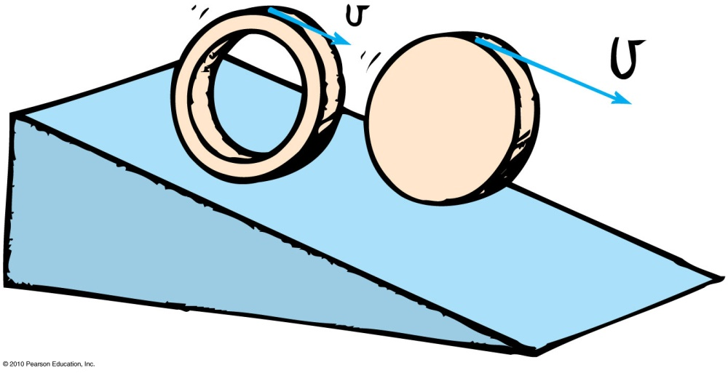
Rotational Inertia
CHECK YOUR NEIGHBOR
A hoop and a disk are released from the top of an incline at the same time. Which one will reach the bottom first?
Hoop
Disk
Both together
Not enough information

Slide 19
Rotational Inertia
CHECK YOUR ANSWER
A hoop and a disk are released from the top of an incline at the same time. Which one will reach the bottom first?
Hoop
Disk
Both together
Not enough information
Explanation:
Hoop has larger rotational inertia, so it will be slower in gaining speed.
Notes:
Explanation
The mass of the hoop is more toward the circumference, compared to the disk in which it is uniformly spread out.
So, the rotational inertia of the hoop is larger than the disk
So, the hoop will be harder to rotate, and will reach the bottom later.

Slide 20
Torque
The tendency of a force to cause rotation is called torque.
Torque depends upon three factors:
  Magnitude of the force
  The direction in which it acts
  The point at which it is applied on the object

Slide 21
Torque
The equation for Torque is
The lever arm depends upon
  where the force is applied.
  the direction in which it acts.
Torque = lever arm × force

Slide 22
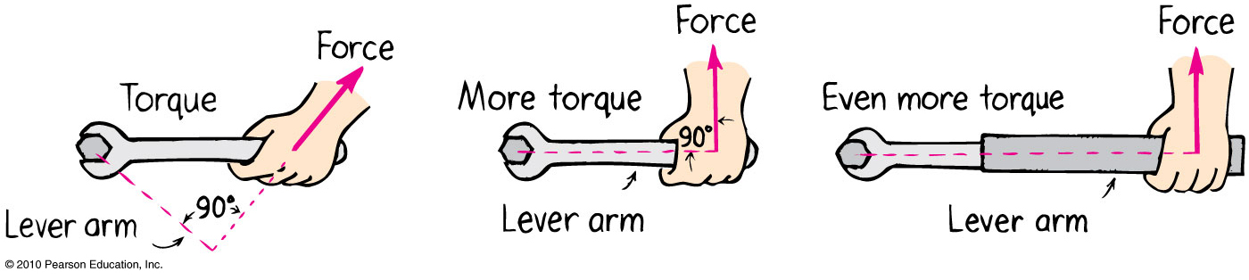
Torque—Example
1st picture: Lever arm is less than length of handle because of direction of force.
2nd picture: Lever arm is equal to length of handle.
3rd picture: Lever arm is longer than length of handle.

Slide 23
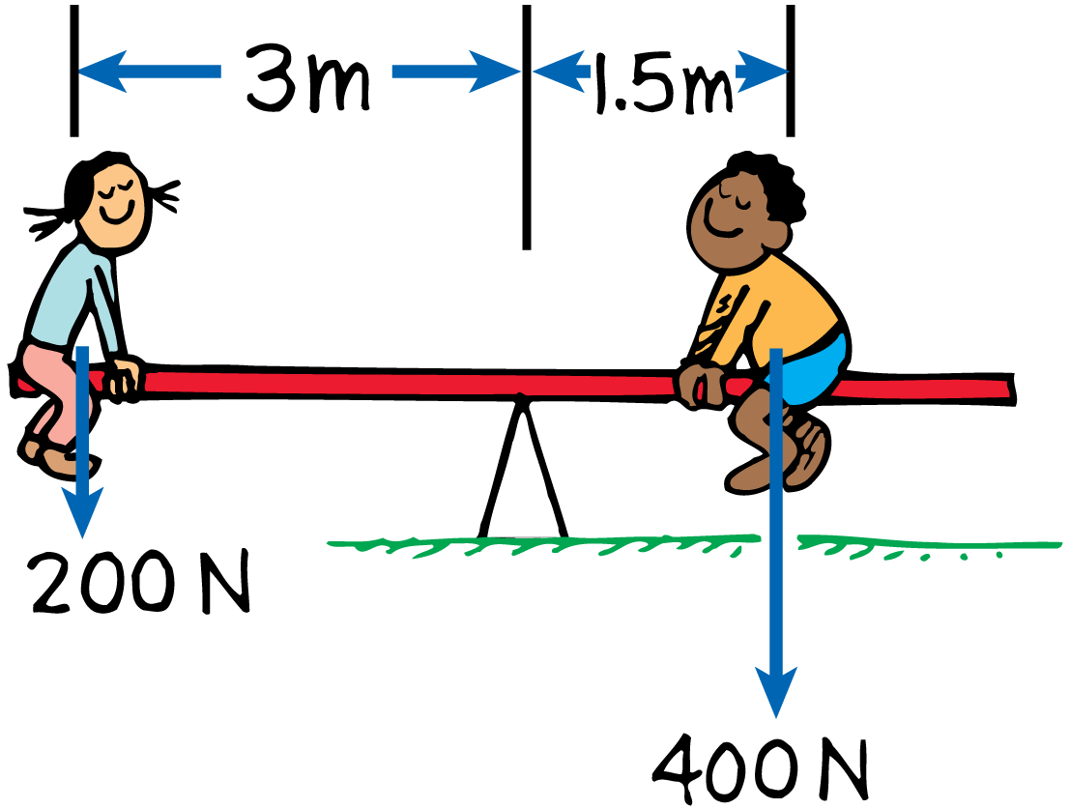
Balanced Torques
A pair of torques can balance each other. Balance is achieved if the torque that tends to produce clockwise rotation by the boy equals the torque that tends to produce counterclockwise rotation by the girl.

Slide 24
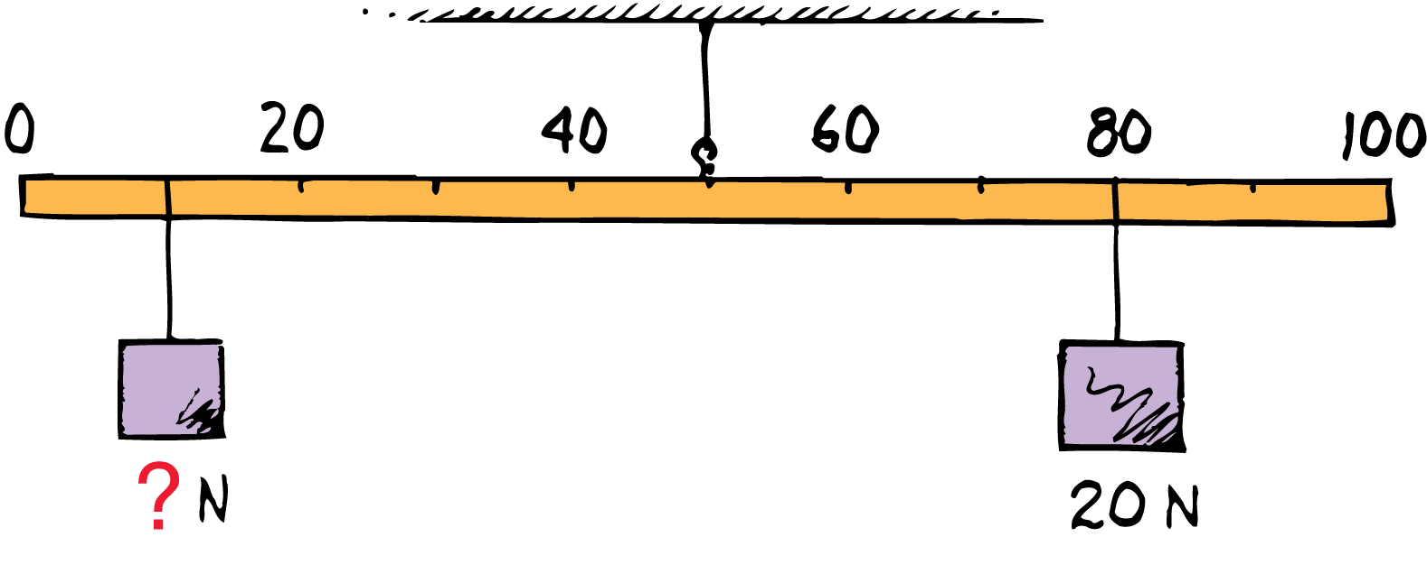
Balanced Torques
do the math!
What is the weight of the block hung at the 10-cm mark?

Slide 25
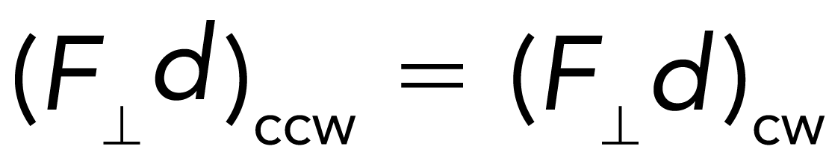
Balanced Torques
do the math!
The block of unknown weight tends to rotate the system of blocks and stick counterclockwise, and the 20-N block tends to rotate the system clockwise. The system is in balance when the two torques are equal:
counterclockwise torque = clockwise torque

Slide 26
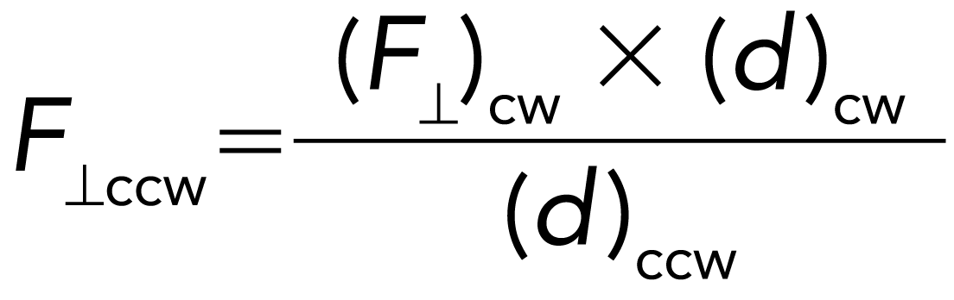
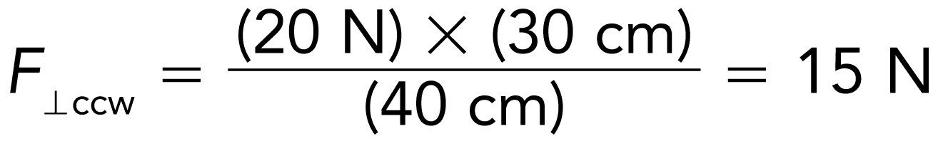
Balanced Torques
do the math!
Rearrange the equation to solve for the unknown weight:
The lever arm for the unknown weight is 40 cm.
The lever arm for the 20-N block is 30 cm.
The unknown weight is thus 15 N.

Slide 27
Center of Mass and Center of Gravity
Center of mass is the average position of all the mass that makes up the object.
Center of gravity (CG) is the average position of weight distribution.
  Since weight and mass are proportional, center of gravity and center of mass usually refer to the same point of an object.

Slide 28
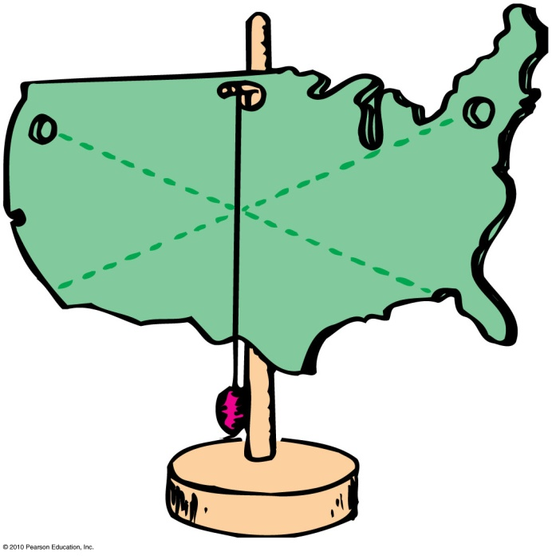
Center of Mass and Center of Gravity
To determine the center of gravity,
  suspend the object from a point and draw a vertical line from suspension point.
  repeat after suspending from another point.
The center of gravity lies where the two lines intersect.

Slide 29
Center of Mass
A baseball thrown into the air follows a smooth parabolic path. A baseball bat thrown into the air does not follow a smooth path.
The bat wobbles about a special point. This point stays on a parabolic path, even though the rest of the bat does not.
The motion of the bat is the sum of two motions:
  a spin around this point, and
  a movement through the air as if all the mass were concentrated at this point.
This point, called the center of mass, is where all the mass of an object can be considered to be concentrated.

Slide 30
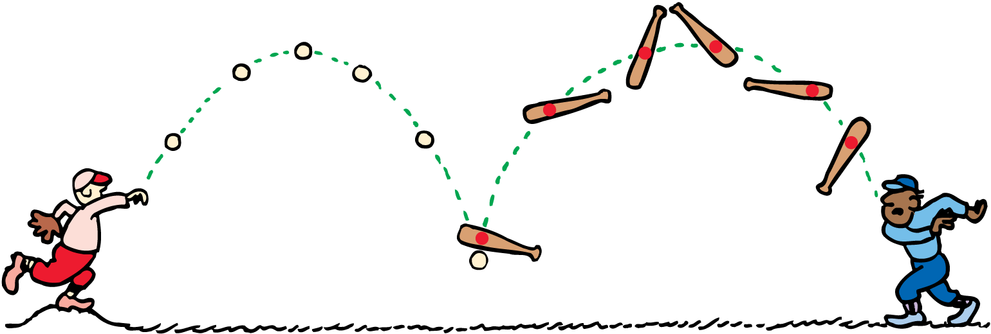
Center of Mass
The centers of mass of the baseball and of the spinning baseball bat each follow parabolic paths.

Slide 31
Center of Mass
Location of the Center of Mass
For a symmetrical object, such as a baseball, the center of mass is at the geometric center of the object.
For an irregularly shaped object, such as a baseball bat, the center of mass is toward the heavier end.

Slide 32
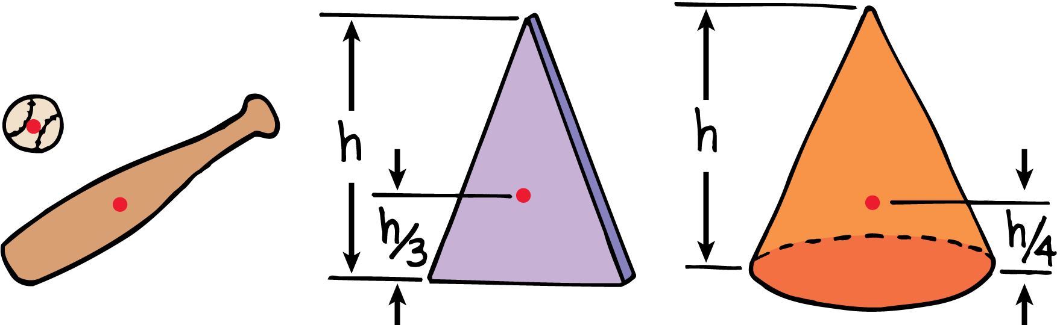
Center of Mass
The center of mass for each object is shown by the red dot.

Slide 33
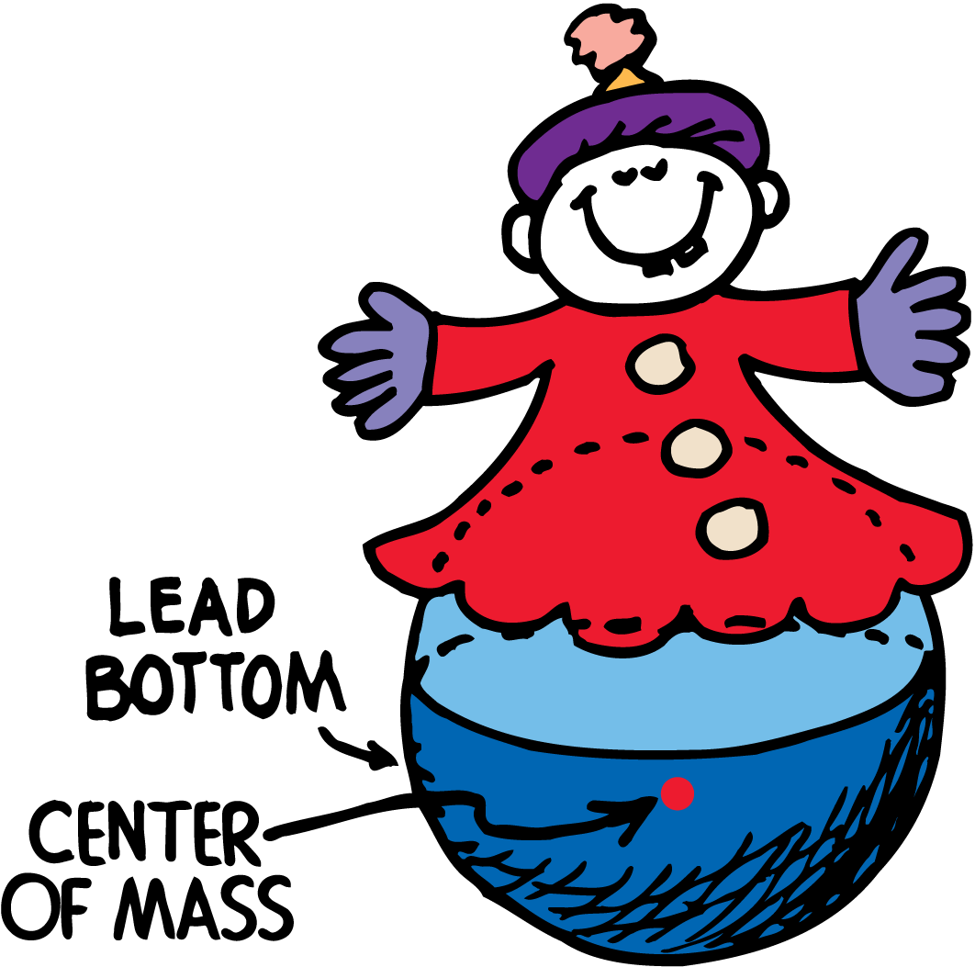
Center of Mass
The center of mass of the toy is below its geometric center.

Slide 34
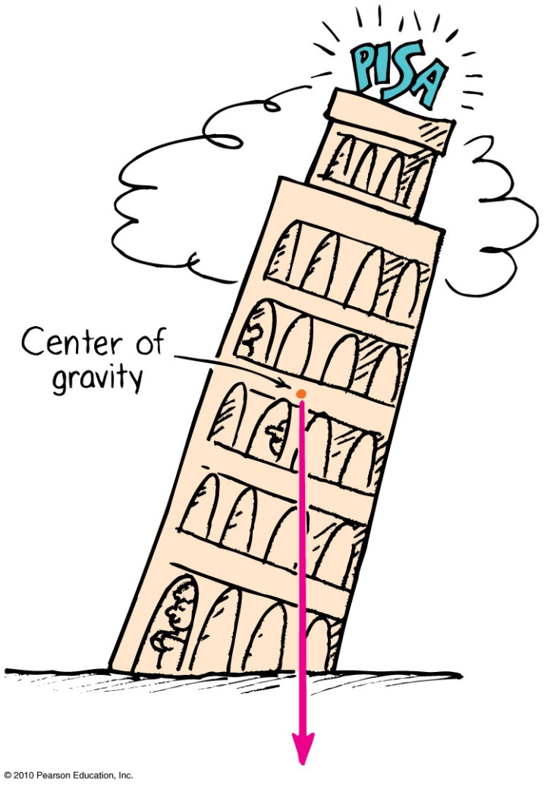
Center of Gravity—Stability
The location of the center of gravity is important for stability.
If we draw a line straight down from the center of gravity and it falls inside the base of the object, it is in stable equilibrium; it will balance.
If it falls outside the base, it is unstable.

Slide 35
Torque and Center of Gravity
The Rule for Toppling
If the CG extends outside the area of support, an unbalanced torque exists, and the object will topple.

Slide 36
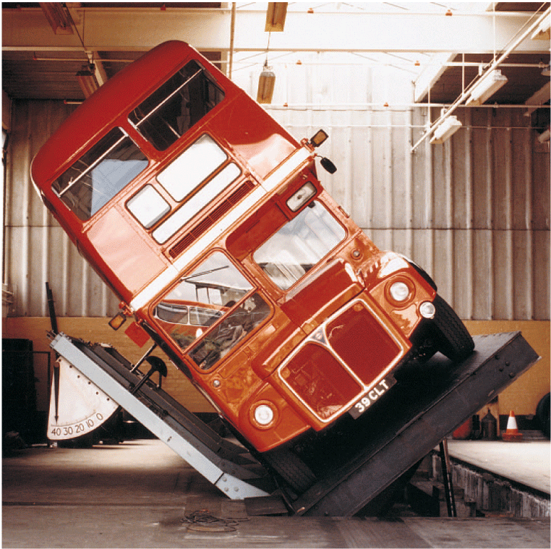
Torque and Center of Gravity
This “Londoner” double-decker bus is undergoing a tilt test.
So much of the weight of the vehicle is in the lower part that the bus can be tilted beyond 28° without toppling.

Slide 37
Torque and Center of Gravity
The Leaning Tower of Pisa does not topple because its CG does not extend beyond its base.
A vertical line below the CG falls inside the base, and so the Leaning Tower has stood for centuries.
If the tower leaned far enough that the CG extended beyond the base, an unbalanced torque would topple the tower.

Slide 38
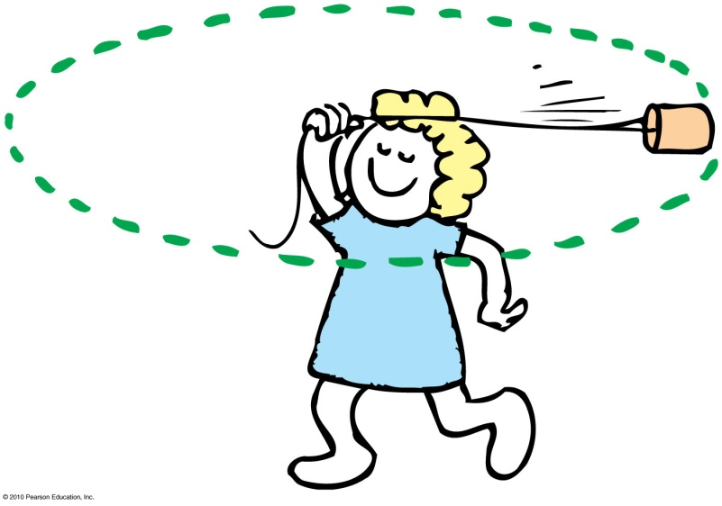
Centripetal Force
Any force directed toward a fixed center is called a centripetal force.
Centripetal means “center-seeking” or “toward the center.”
Example: To whirl a tin can at the end of a string, you pull the string toward the center and exert a centripetal force to keep the can moving in a circle.

Slide 39
Centripetal Force
Depends upon
  mass of object.
  tangential speed of the object.
  radius of the circle.
In equation form:
m
a
s
s
×
t
a
n
g
e
n
t
i
a
l
s
p
e
e
d
2
C
e
n
t
r
i
p
e
t
a
l
f
o
r
c
e
=
r
a
d
i
u
s

Slide 40
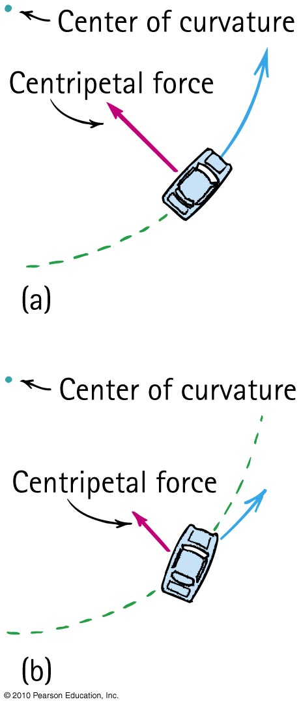
Centripetal Force—Example
When a car rounds a curve, the centripetal force prevents it from skidding off the road.
If the road is wet, or if the car is going too fast, the centripetal force is insufficient to prevent skidding off the road.

Slide 41
Centripetal Force
CHECK YOUR NEIGHBOR
Suppose you double the speed at which you round a bend in the curve, by what factor must the centripetal force change to prevent you from skidding?
Double
Four times
Half
One-quarter

Slide 42
Centripetal Force
CHECK YOUR ANSWER
Suppose you double the speed at which you round a bend in the curve, by what factor must the centripetal force change to prevent you from skidding?
Double
Four times
Half
One-quarter
Explanation:
Because the term for “tangential speed” is squared, if you double the tangential speed, the centripetal force will be double squared, which is four times.
mass ×
tangential
speed
2
Centripeta
l
force
=
radius

Slide 43
Centripetal Force
CHECK YOUR NEIGHBOR
Suppose you take a sharper turn than before and halve the radius, by what factor will the centripetal force need to change to prevent skidding?
Double
Four times
Half
One-quarter

Slide 44
Centripetal Force
CHECK YOUR ANSWER
Suppose you take a sharper turn than before and halve the radius; by what factor will the centripetal force need to change to prevent skidding?
Double
Four times
Half
One-quarter
Explanation:
Because the term for “radius” is in the denominator, if you halve the radius, the centripetal force will double.
mass ×
tangential
speed
2
Centripeta
l
force
=
radius

Slide 45
Centrifugal Force
Although centripetal force is center directed, an occupant inside a rotating system seems to experience an outward force. This apparent outward force is called centrifugal force.
Centrifugal means “center-fleeing” or “away from the center.”

Slide 46
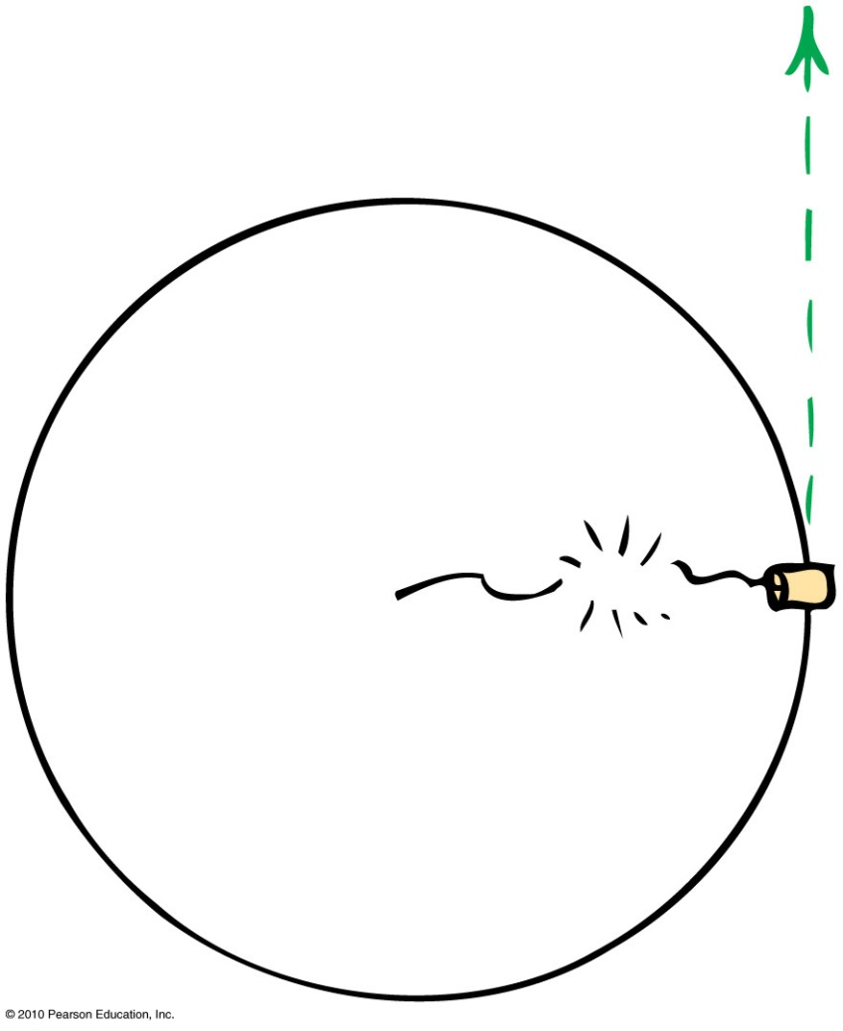
Centrifugal Force
– A Common Misconception
It is a common misconception that a centrifugal force pulls outward on an object.
Example:
  If the string breaks, the object doesn’t move radially outward.
  It continues along its tangent straight-line path—because no force acts on it. (Newton’s first law)

Slide 47
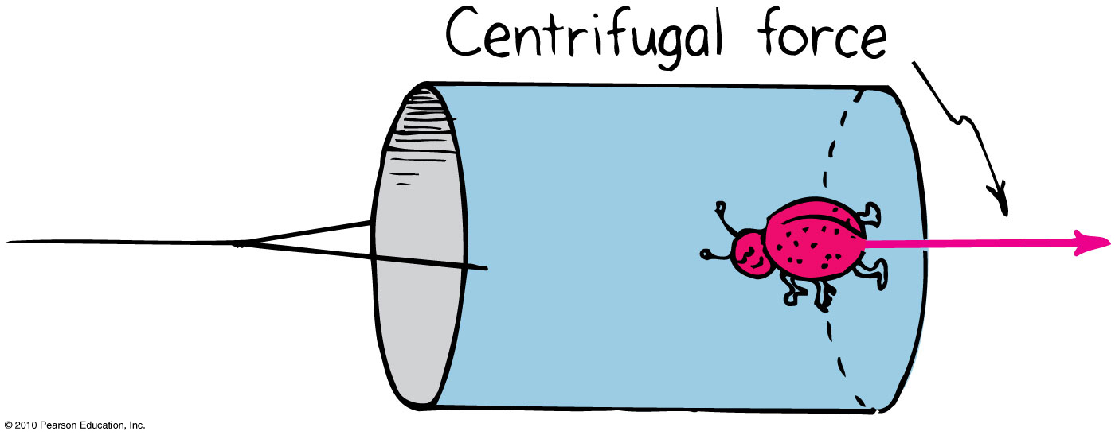
Rotating Reference Frames
Centrifugal force in a rotating reference frame is a force in its own right – as real as any other force, e.g. gravity.
Example:
  The bug at the bottom of the can experiences a pull toward the bottom of the can.

Slide 48
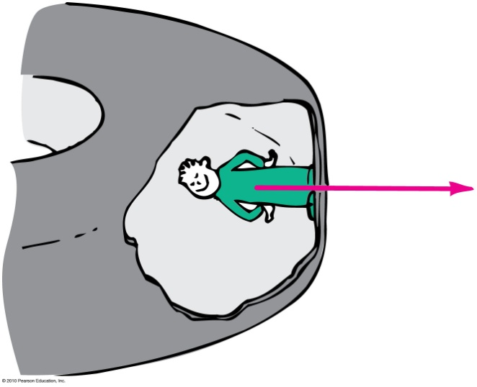

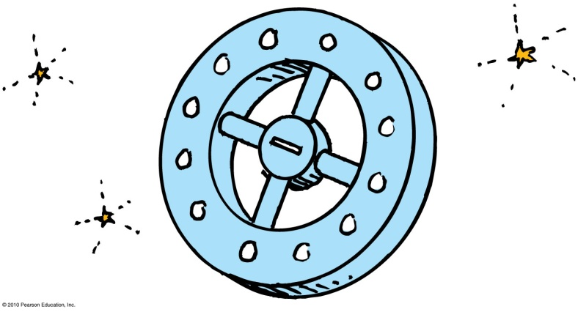
Simulated Gravity
Centrifugal force can be used to simulate gravity in space stations of the future.
By spinning the space station, occupants would experience a centrifugal force (simulated gravity) similar to the bug in the can.

Slide 49

Simulated Gravity
To simulate an acceleration due to gravity, g, which is 10 m/s², a space station must
have a radius of about 1 km (i.e. diameter of 2 km).
rotate at a speed of about
1 revolution per minute.

Slide 50
Angular Momentum
The “inertia of rotation” of rotating objects is called angular momentum.
  This is analogous to “inertia of motion”, which was momentum.
Angular momentum
= rotational inertia × angular velocity
  This is analogous to
  Linear momentum = mass × velocity

Slide 51
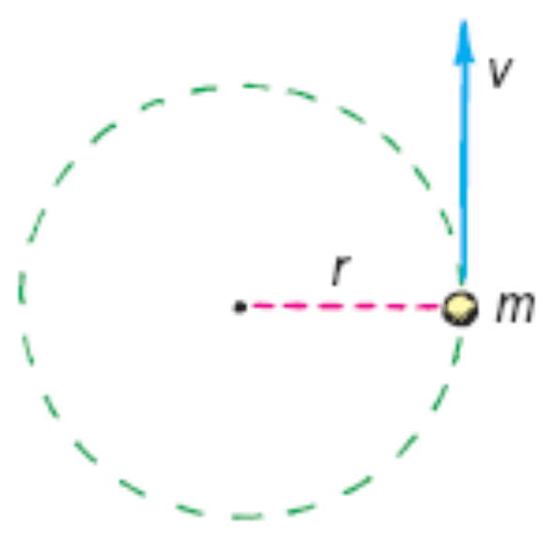
Angular Momentum
For an object that is small compared with the radial distance to its axis, magnitude of
Angular momentum = mass tangential speed × radius
  This is analogous to magnitude of
  Linear momentum = mass × speed
Examples:
  Whirling ball at the end of a long string
  Planet going around the Sun

Slide 52
Angular Momentum
An external net torque is required to change the angular momentum of an object.
Rotational version of Newton’s first law:
  An object or system of objects will maintain its angular momentum unless acted upon by an external net torque.

Slide 53
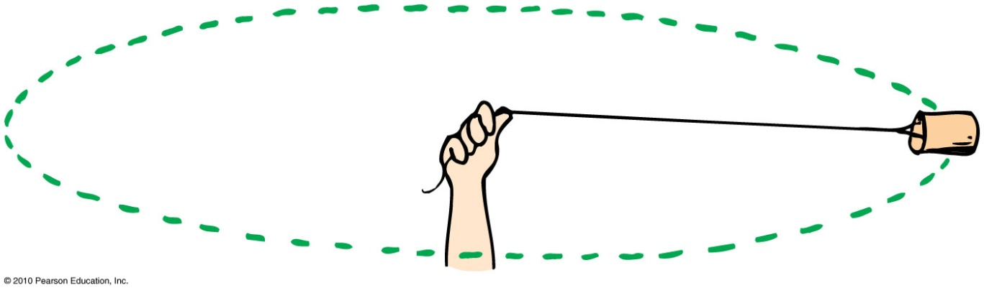
Angular Momentum
CHECK YOUR NEIGHBOR
Suppose you are swirling a can around and suddenly decide to pull the rope in halfway; by what factor would the speed of the can change?
Double
Four times
Half
One-quarter

Slide 54
Angular Momentum
CHECK YOUR ANSWER
Suppose you are swirling a can around and suddenly decide to pull the rope in halfway, by what factor would the speed of the can change?
Double
Four times
Half
One-quarter
Explanation:
Angular Momentum is proportional to radius of the turn.
No external torque acts with inward pull, so angular momentum is conserved. Half radius means speed doubles.
Angular momentum
= mass tangential speed × radius

Slide 55
Conservation of Angular Momentum
The law of conservation of angular momentum states:
  If no external net torque acts on a rotating system, the angular momentum of that system remains constant.
Analogous to the law of conservation of linear momentum:
  If no external force acts on a system, the total linear momentum of that system remains constant.

Slide 56
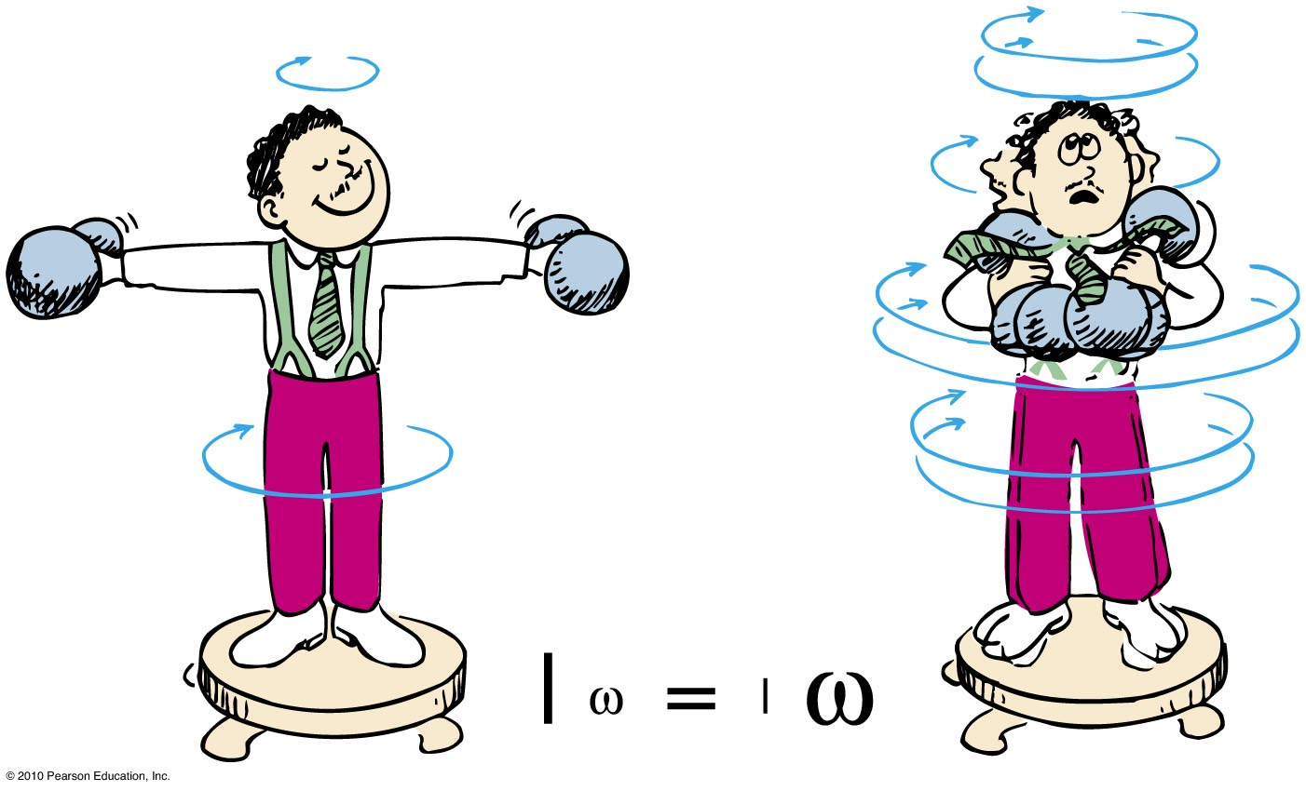
Conservation of Angular Momentum
Example:
When the man pulls the weights inward, his rotational speed increases!

Slide 57
Angular Momentum
CHECK YOUR NEIGHBOR
Suppose by pulling the weights inward, the rotational inertia of the man reduces to half its value. By what factor would his angular velocity change?
Double
Three times
Half
One-quarter
Notes:
A. double

Slide 58
Angular Momentum
CHECK YOUR ANSWER
Suppose by pulling the weights in, if the rotational inertia of the man decreases to half of his initial rotational inertia, by what factor would his angular velocity change?
Double
Three times
Half
One-quarter
Explanation:
Angular momentum is proportional to “rotational inertia”.
If you halve the rotational inertia, to keep the angular momentum constant, the angular velocity would double.
Angular momentum
= rotational inertia × angular velocity

